Slide 1
Macros 2

Slide 2
Two major topics today
Variable capture – a common issue with macros that you should be aware of and how racket macros avoid it mostly
How to do more complex calculations in the macro expansion phase

Slide 3

Macro templates are good but have limits
(define-syntax numed-syms
(lambda (stx)
(datum->syntax stx
(list 'quote (let recur ([num 0]
[syms (cdr (syntax->datum stx))])
(if (null? syms)
'()
(cons (cons (car syms) num)
(recur (add1 num) (cdr syms)))))))))
By treating code as fully data, we get plenty of power

Slide 4
Variable Capture Problems
(define-syntax badswap
(lambda (stx)
(datum->syntax stx (let* ([orig (syntax->datum stx)]
[v1 (cadr orig)]
[v2 (caddr orig)])
(list 'let (list (list 'tmp v1))
(list 'set! v1 v2)
(list 'set! v2 'tmp))))))
(define a 1)
(define b 2)
(badswap a b) ; works
(define q 3)
(define tmp 99)
(badswap q tmp) ; variables are not swapped

Slide 5
2 Types of Variable Captures Problems
A variable created by the macro “captures” some name that has meaning to the program that calls the macro and changes it
The local context in which the macro is called “captures” some free variable intended to be global context from where the macro was declared
(let ((set! '(1 2 3)))
(badswap a b))

Slide 6
Mostly solved by racket syntax
(define-syntax (swap stx)
(syntax-case stx ()
[(swap x y)
#'(let ([tmp x])
(set! x y)
(set! y tmp))]))
X and Y and syntax objects with their own namespace
The variable created here has a different namespace
Variables referenced within the macro use the macro’s namspace

Slide 7
Sometimes we want to capture
Put in the namespace of the transformed code, not the generated code
(define-syntax print-x
(lambda (stx)
(syntax-case stx ()
[(print-x) (with-syntax ([x-in-context (datum->syntax stx 'x)])
#'(printf "x is ~s~n" x-in-context))])))
(let ((x 3)) (print-x))
Other values not specially constructed however, are still safe from capture

Slide 8
Activity if-it
Sometimes we want to use the value of an if test
(if (do-big-calculation 100) (+ 1 (do-big-calculation 100)) #failed)
What if we had a variant of if that bound the test to a variable “it”. The equivalent of:
(let ((it (do-big-calculation 100)) (if it (+ 1 it) #failed))
But without having to explicitly do the let
(if (do-big-calculation 100) (+ 1 it) #failed)
Hint: You’ll want to define it similar to the way we did x in the example.

Slide 9
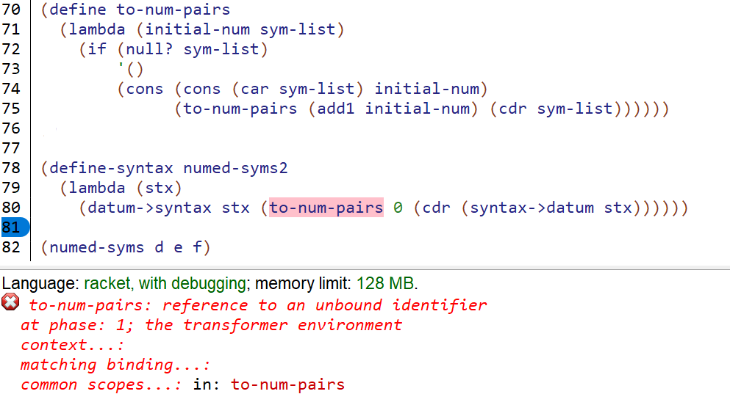
Macro Expansion occurs before execution

Slide 10
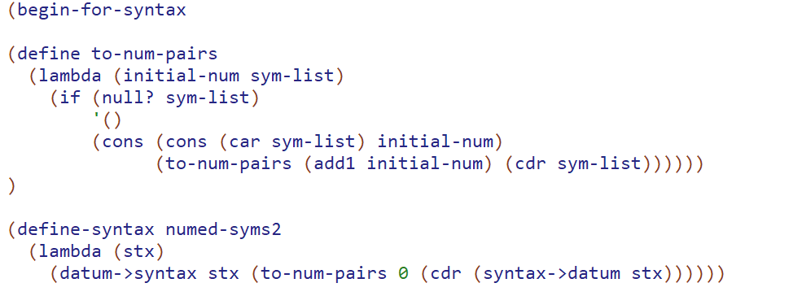

Slide 11
Some things are best computed at expansion time
Consider a situation is which we want to have a bunch of numbers corresponding to different types or states or whatever. Vanilla might be 1 Chocolate might be 2, etc. The key here is each unique thing must have a unique number, but we don’t care what the number is.
We could have a global list and function (get-key ‘vanilla) that will return the key for vanilla (and add it to the list and give it an unused number if it needs to). But this can be kinda inefficient:
(define has-null-keys?
(lambda (lst)
(if (null? lst)
#f
(or (= (get-key ‘null) (car lst))
(has-null-keys? (cdr lst))))))

Slide 12
Activity: Log Level
For code that logs errors its common to have the idea of a “log level” which is a global setting.
(log 2 “handling incoming data ~s” data)
If the log level is set to 2 or higher this line will print. Otherwise not. In this code 2 is always an explicit number, never a variable or expression.
BUT we’d like this to happen through macros so that we don’t pay any overhead for unused log calls. So log will be a macro that expands to (void) if the log level is not high enough and to (printf all params except log level) if it is high enough.

